Slide 1
Security and safety issues
WP1
Roundtable

Slide 2
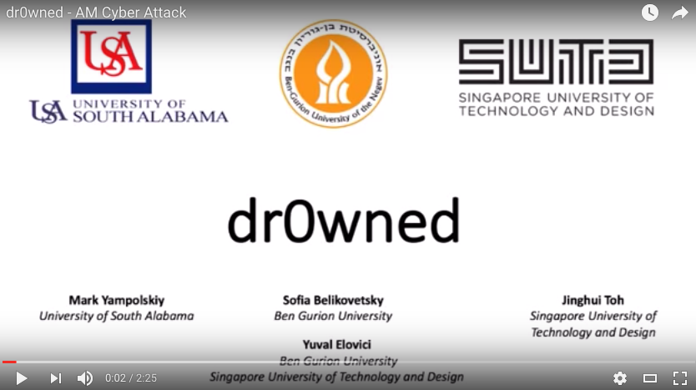
Security for safe devices
Unsecure e-platform can lead to unsafe devices
https://www.youtube.com/watch?v=zUnSpT6jSys

Slide 3
Possible failure in security
Failure | (Possible) cause(s) | (Possible) solution(s)
Lost and integrity of design data | Server crash | Multiple servers, working on local copy and do commit
 | Unwanted or concurrent cancellation | SVN
 | Malicious modification | Password, multiple check, tracking
Leakage of Patients personal and sensitive and data | Sensitive data uploaded on UBORA by error | Anonymization (see data management plan WP5)

Slide 4
References and further readings
http://www.3ders.org/articles/20161020-dr0wned-researchers-highlight-security-concerns-with-3d-printing-by-downing-a-drone.html
https://arxiv.org/abs/1609.00133

